Slide 1
Crunching
CrunchBase
Researching the startup industry
Daniel Shin

Slide 2
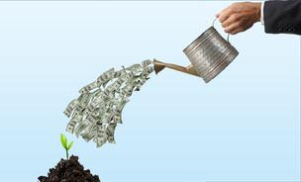

Risky business
Investors/VCs
“is this a good company to invest in?”
Startups/founders
“what is my chance of success?”
“who is my competition?”
Notes:
http://spectrum.ieee.org/images/apr05/images/venture.capital.two.jpg
http://www.careerdigressions.com/wp-content/uploads/2014/08/startup.jpg

Slide 3
A tale of two startups
Founded 2005
Market: Personal finance
San Francisco, CA
$4 million Series A
Founded 2006
Market: Personal finance
Mountain View, CA
$4.7 million Series A
Company A
Company B
Notes:
Two companies founded around the same time, in the same location, market, and similar series A funding

Slide 4
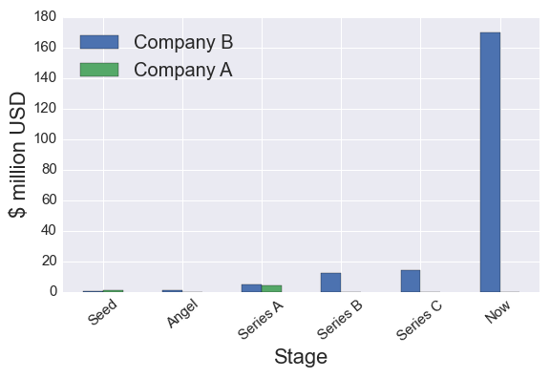
The outcome
Company B
acquired by Intuit for $170 million
in 2009
Company A
closed down in 2010

Slide 5

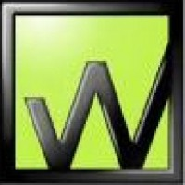
The outcome

Slide 6


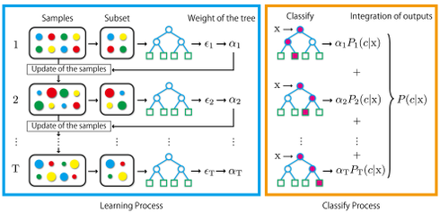


Predicting success
Random Forest Classifier
>57,000 companies
Notes:
limited publicly available data
limited time (more time makes feasible)
cross val score is 58%
resolution for company outcomes is outpaque
what defines a company’s success is

Slide 7
Predicting success
X
Random Forest Classifier
>57,000 companies
Notes:
limited publicly available data
limited time (more time makes feasible)
cross val score is 58%
resolution for company outcomes is outpaque
what defines a company’s success is

Slide 8
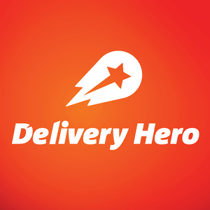



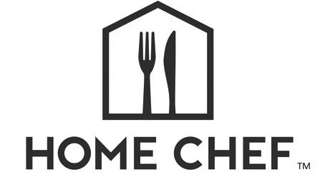


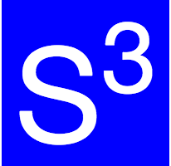
Startup Similarity Search (S³)
company information
57,000 x 244,000
sparse matrix
Reduced
57,000 x 500
matrix
TF-IDF
vectorizer
Recommendation engine:
A tool for finding similar companies
NLP
Applies nearest neighbors algorithm to company description/market data
Truncated
SVD
Nearest
Neighbors

Slide 9
Demo

Slide 10
